Slide 1
CAPSTONE PROJECT
IMDB MOVIE REVIEWS
Presented By: AKASH.V.S - ALAGAPPA COLLEGE OF TECHNOLOGY, ANNA UNIVERSITY- CENTRE FOR BIOTECHNOLOGY ( PHARMA )

Slide 2
OUTLINE:
Problem Statement
Proposed System/Solution
System Development Approach
Algorithm & Deployment
Result
Conclusion
Future Scope
References

Slide 3
PROBLEM STATEMENT
Movie dataset for binary sentiment classification containing substantially more data than previous benchmark datasets. We provide a set of 25,000 highly polar movie reviews for training and 25,000 for testing. So, predict the number of positive and negative reviews using either classification or deep learning algorithms.

Slide 4
PROPOSED SOLUTION
The solution for the problem statement given was to segregate the positive and negative reviews using the Naïve Bayes classification algorithm.
What is Naïve Bayes Algorithm?
Naïve Bayes algorithm is a supervised learning algorithm, which is based on Bayes theorem and used for solving classification problems.
It is mainly used in text classification that includes a high-dimensional training dataset.
Naïve Bayes Classifier is one of the simple and most effective Classification algorithms which helps in building the fast machine learning models that can make quick predictions.
It is a probabilistic classifier, which means it predicts on the basis of the probability of an object.

Slide 5

Why is it called Naïve Bayes?
The Naïve Bayes algorithm is comprised of two words Naïve and Bayes, Which can be described as:
Naïve: It is called Naïve because it assumes that the occurrence of a certain feature is independent of the occurrence of other features. Such as if the fruit is identified on the bases of color, shape, and taste, then red, spherical, and sweet fruit is recognized as an apple. Hence each feature individually contributes to identify that it is an apple without depending on each other.
Bayes: It is called Bayes because it depends on the principle of Bayes' Theorem.
Bayes' Theorem:
Bayes' theorem is also known as Bayes' Rule or Bayes' law, which is used to determine the probability of a hypothesis with prior knowledge. It depends on the conditional probability.
The formula for Bayes' theorem is given as:
Where,
P(A|B) is Posterior probability: Probability of hypothesis A on the observed event B.
P(B|A) is Likelihood probability: Probability of the evidence given that the probability of a hypothesis is true.
P(A) is Prior Probability: Probability of hypothesis before observing the evidence.
P(B) is Marginal Probability: Probability of Evidence.

Slide 6
SYSTEM APPROACH
Working of Naïve Bayes' Classifier:
Working of Naïve Bayes' Classifier can be understood by following the below steps with the given problem statement and dataset:
Convert the given dataset into frequency tables.
Generate Likelihood table by finding the probabilities of given features.
Now, use Bayes theorem to calculate the posterior probability.
I have implemented a Naive Bayes Algorithm using Python on Google Colab. So for this, I used the given data set “Imdb_dataset.csv”
Steps to implement:
Data Pre-processing step
Fitting Naive Bayes to the Training set
Predicting the test result
Test accuracy of the result(Creation of Confusion matrix)
Visualizing the test set result.

Slide 7
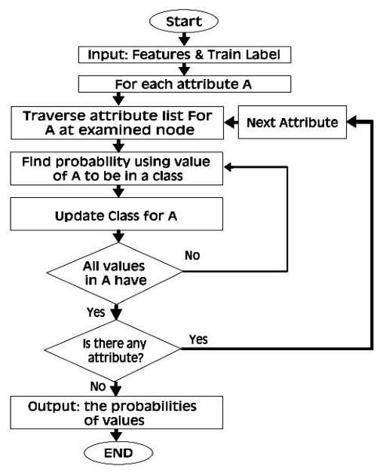
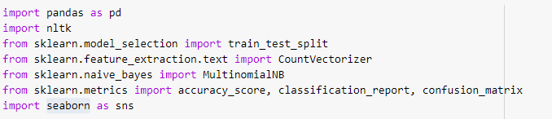
ALGORITHM & DEPLOYMENT
Libraries imported include:
pandas
Nltk
train_test_split
CountVectorizer
MultinomialNB
accuracy_score
classification_report
confusion_matrix
Seaborn ( as sns )

Slide 8
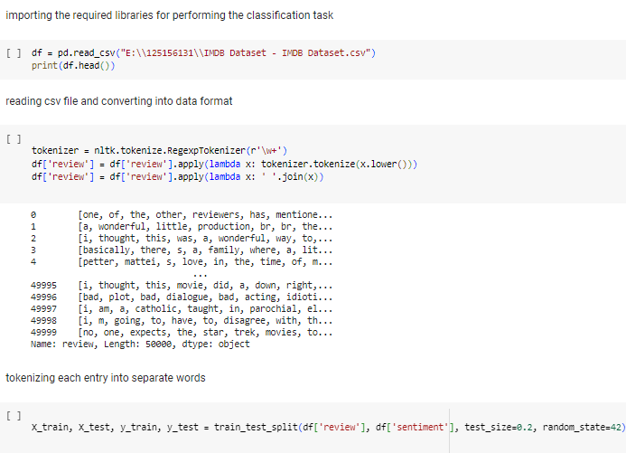
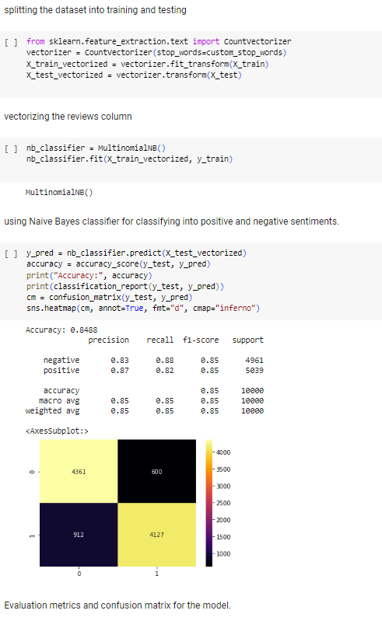

Slide 9
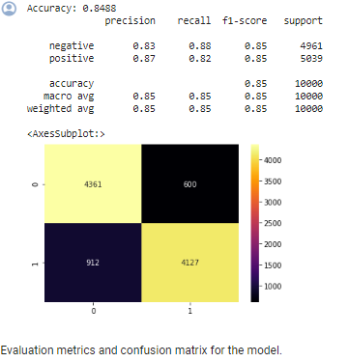
RESULT
Based upon the given training dataset, the classifier algorithm was ran, and was able to predict whether the given movie review was a positive or negative one, with an average accuracy of 84.88%

Slide 10
CONCLUSION
The movie dataset for binary sentiment classification containing substantially more data than previous benchmark datasets was studies. Using the provided set of 50,000 highly polar movie reviews, of which 40,000 were used for training and 10,000 for testing, to achieve more accuracy. So, the number of positive and negative reviews were correctly predicted after running out tests, and the accuracy was checked using a confusion matrix.

Slide 11
FUTURE SCOPE
Applications of Naïve Bayes Classifier:
It is used for Credit Scoring.
It is used in medical data classification.
It can be used in real-time predictions because Naïve Bayes Classifier is an eager learner.
It is used in Text classification such as Spam filtering and Sentiment analysis.
Note: from this process, it was inferred that TF-IDF can be used to vectorize text into a format more agreeable for ML & NLP techniques, and different approaches of the same vectorizers can be used for other data classification situations.

Slide 12
REFERENCES
https://www.javatpoint.com/machine-learning-naive-bayes-classifier
https://www.capitalone.com/tech/machine-learning/understanding-tf-idf/
https://www.researchgate.net/figure/Flowchart-of-Naive-Bayes-algorithm_fig4_354303930
https://github.com/bamtak/machine-learning-implemetation-python/blob/master/Binary%20Naive%20Bayes.ipynb

Slide 13
THANK YOU!

